Slide 1
Know Scala?
By Rajeev & Jugul

Slide 2
Agenda
Scala Setup
Eclipse Plugin
Command Line
SBT
FP
Scala Classes and Objects
Inheritance and Its Implementation in Scala
Traits
Scala Type Hierarchy

Slide 3
Scala Setup
Scala Eclipse:
For Scala setup prerequisite is JDK . So you must have jdk install on your system . Jdk must be compatible with you Scala version . So when you try to install the Scala or download the Scala please read docs for compatible version of jdk .
To setup the Scala in eclipse you need to go to below link
http://scala-ide.org/download/current.html
Download the eclipse or you and choose the plugin for the eclipse as well .
Scala Command Line
To setup scala on command line you need to download its binary version
https://www.scala-lang.org/download/
You just download the Scala as per compatible of you system .
Notes:
In all programs, there are two primary components: the data (the stuff a program knows) and the behaviors (the stuff a program can do to/with that data). OOP says that bringing together data and its associated behavior in a single location (called an “object”) makes it easier to understand how a program works. FP says that data and behavior are distinctively different things and should be kept separate for clarity.
Whenever you write some code to deal with data about people then functional programming seems to work best.
Whenever you write some code to simulate people then object-oriented programming seems3 to work best.
Study at Yale
In one study a team at Yale asked teams to code solutions to a problem using a range of programming languages, including:
Haskell
Ada
C++
Awk
Criteria used to evaluate the solutions were:
Extensibility
Understandability
Appropriateness
Accuracy
Compactness
Haskell, a functional language, was the clear winner. Given the possible variation in the skills of the teams, the study authors then had a graduate student learn Haskell for a week before attempting to code the solution. While not as effective as the experienced Haskell developers’ solution, the student’s submission came in second.
Now, this study was conducted in 1994, and development has moved on a long way since then. So…
Study at the University of California
Fast forward to 2014 and researchers at the University of California, Davis studied the following question: What is the effect of programming languages on software quality?
To do this, they took a dataset from GitHub. This dataset covered:
729 projects
80m lines of code
29000 contributors
1.5m commits
17 programming languages
The projects were real-world products—such as Linux, MySQL, bitcoin, etc.
They concluded that:
functional languages are better than procedural languages
strong typing is better than weak typing
static typing is better than dynamic
managed memory usage is better than unmanaged

Slide 4
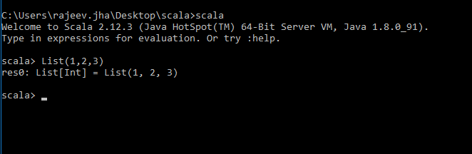
Scala commandLine
After extracting set the Scala path in environment variable and open any console and type Scala
Now you can execute your simple code in this Scala interpreter .

Slide 5
Referential transparency, purity, and the substitution model
Scala interpreter (also known as the Read-Eval-Print-Loop)
Functional programming
we construct our programs using only pure functions—in other words, functions
that have no side effects. What are side effects? A function has a side effect if it
does something other than simply return a result, for example
Modifying a variable
Modifying a data structure in place
Setting a field on an object
Throwing an exception or halting with an error
Printing to the console or reading user input
Reading from or writing to a file
Drawing on the screen

Slide 6
Continue…
Simple program with side effects
class Cafe {
def buyCofee(cc: CreditCard): Cofee = {
val cup = new Cofee(cofeePrice)
cc.charge(cup.price)
cup
}
Charging a credit card-involves some interaction with the outside world
Actions are happening on-the side, hence the term “side effect.”
def buyCoffee(cc: CreditCard, p: Payments): Coffee = {
val cup = new Coffee()
p.charge(cc, cup.price)
cup
}

Slide 7
Continue….
A functional solution: removing the side effects
def buyCofee(cc: CreditCard):(Cofee, Charge)={
val cup=new Cofee(cofeePrice)
(cup, Charge(cc, cup.price))
}
What-is-Charge-Here
case class Charge(cc: CreditCard, amount: Double) {
def combine(other: Charge): Charge =
if (cc == other.cc)
Charge(cc, amount + other.amount)
else
throw new Exception("Can't combine charges to different cards")
}

Slide 8
Continues…
def buyCoffees(cc: CreditCard, n: Int): (List[Coffee], Charge) = {
val purchases: List[(Coffee, Charge)] = List.fill(n)(buyCoffee(cc))
val (coffees, charges) = purchases.unzip
(coffees, charges.reduce((c1,c2) => c1.combine(c2)))
}
def coalesce(charges: List[Charge]): List[Charge] =
charges.groupBy(_.cc).values.map(_.reduce(_ combine _)).toList
Exactly what is a (pure) function?
Referential transparency and purity

Slide 9
Scala Classes
There are different way we can create the class in Scala and each approach has its business requirement.
Syntax
Classs <className>(<var>/<val> <namePro>:<Type>,..){
}
Another way to create the class is
Class <className>{
<var>/<val> <nameProp>:<type>=<some value>
}
In scala, if you don't specify primary constructor, compiler creates a constructor which is known as primary constructor. All the statements of class body treated as part of constructor. It is also known as default constructor.
There are different type of class as well like case class & companion class we discuss these later
Below are the point which need to remember :-
If a field is declared as a var, Scala generates both getter and setter methods for that field.
If the field is a val, Scala generates only a getter method for it.
If a field doesn’t have a var or val modifier, Scala gets conservative, and doesn’t generate a getter or setter method for the field.
Additionally, var and val fields can be modified with the private keyword, which prevents getters and setters from being generated.

Slide 10
Scala Classes continue…
Scala Singleton :- Scala is more object oriented then java because Scala don’t have static keyword. So to create a singleton object in Scala we don’t need static instead Scala introduce new keyword called object . You define the singleton using object keyword .
Like this .
Object A{
def main(args:Array[String]){
println(“hello scala”)
}
}

Slide 11
Companion object and class
When a singleton object is named the same as a class, it is called a companion object. A companion object must be defined inside the same source file as the class.
class Main {
def sayHelloWorld() {
println("Hello World");
}
}
object Main {
def sayHi() {
println("Hi!");
}
}

Slide 12
Companion class and objects singleton …
Generally singleton object is always used with companion class . We used companion class and companion object for factory design.
sealed trait PersonService{
def getPerson():String
}
private class PersonServiceImpl(private[this] val jString:String) extends PersonService {
private var extraData= ""
override def toString =jString+extraData
def getMsg():String={
return this.jString
}
override def getPerson():String={
return"you can call dao here"
}
}

Slide 13
object PersonServiceImpl {
def sayhello():String={
val obj= PersonServiceImpl("TestObj")
return obj.getMsg()
}
private def apply(base:String) = new PersonServiceImpl(base)
}
We can directly used trait with object but for doing this we need to extend the trait to object .
Companion object and companion classes share the all the properties and behaviour with each other.
Scala - Access Modifiers:
1.Private --- as java
2.Protected --- as java but you cannot access props in same package
3.Private[this] --In Scala you can make members really private by restricting access to only the current instance, which isn’t possible in Java

Slide 14
Trait..
Traits is more like interface in java. Its very important aspect of Scala because Scala collection framework is written on this concept .
A trait encapsulates method and field definitions, which can then be reused by mixing them into classes
Below is syntax for Trait in Scala
trait <nameOfTrait> extends <othertrait> with <OtherTrait>{
}
Important point : - you can’t directly used the trait with java do so you need to create abstract class.

Slide 15
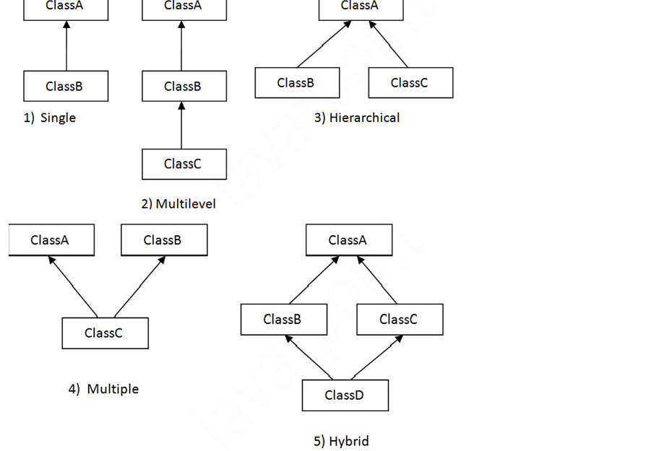
Inheritance ..

Slide 16
Scala support all type of inheritance .
E.g -:
Scala override and constructor explain

Slide 17
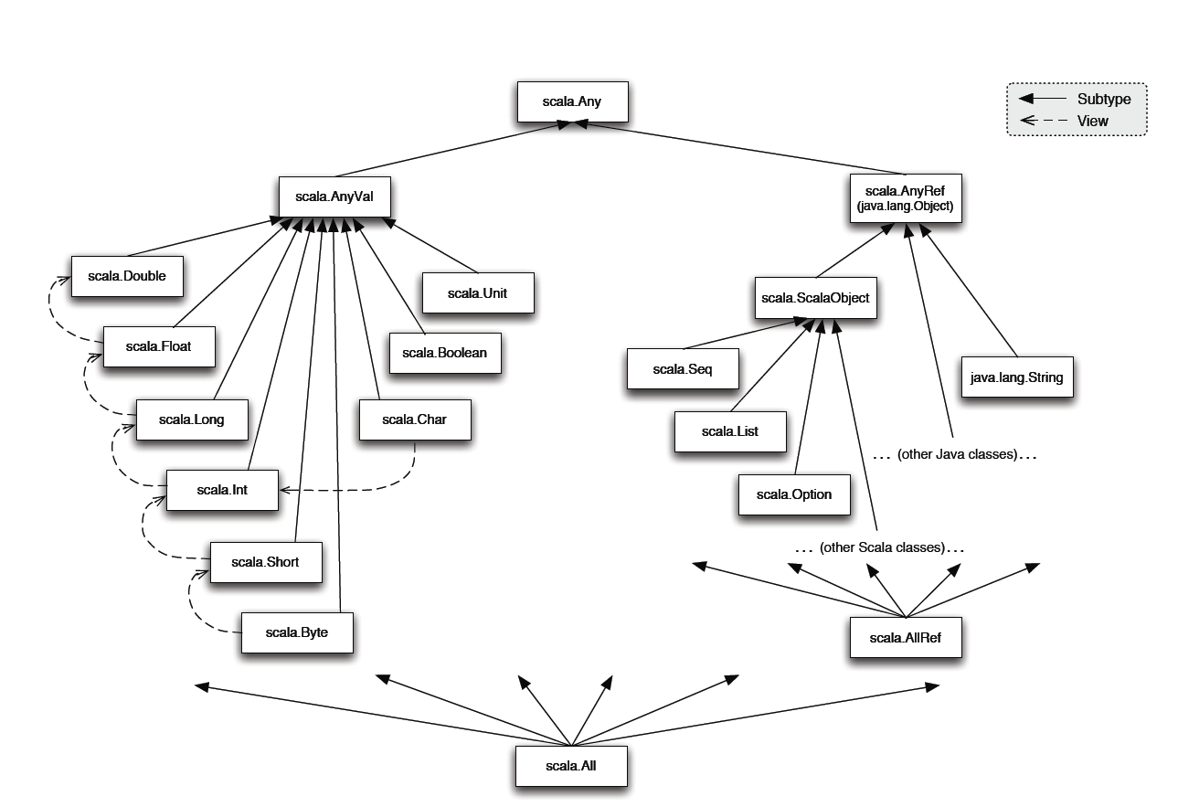
Scala Type Hierarchy

Slide 18
Queries?

Slide 19
Scala cheat sheet (1): Definitions
Scala method definitions:
def fun(x: Int): Int = { result }
def fun = result
Scala variable definitions:
var x: int = expression val x: String = expression
Java method definition:
int fun(int x) { return result }
(no parameterless methods)
Java variable definitions:
int x = expression final String x = expression

Slide 20
Scala cheat sheet (2): Expressions
Scala method calls: obj.meth(arg)
or: obj meth arg
Scala choice expressions: if (cond) expr1 else expr2
expr match { case pat₁ => expr₁ ....
case pat_{n} => expr_{n}
}
Java method call:
obj.meth(arg)
(no operator overloading)
Java choice expressions, stats:
cond ? expr1 : expr2 // expression
if (cond) return expr1; // statement else return expr2;
switch (expr) { case pat₁ : return expr₁; ...
case pat_{n} : return expr_{n} ;
} // statement only

Slide 21
Scala cheat sheet (3): Objects and Classes
Scala Class and Object
class Sample(x: Int) { def instMeth(y: Int) = x + y } object Sample { def staticMeth(x: Int, y: Int) = x * y }
Java Class with static
class Sample { final int x; Sample(int x) { this.x = x } int instMeth(int y) { return x + y; } static int staticMeth(int x, int y) { return x * y; } }

Slide 22
Scala cheat sheet (4): Traits
Scala Trait trait T { def abstractMeth(x: String): String def concreteMeth(x: String) = x+field var field = “!”
}
Scala mixin composition:
class C extends Super with T
Java Interface
interface T { String abstractMeth(String x) (no concrete methods) (no fields) }
Java extension + implementation:
class C extends Super implements T

